Slide 1
Thailand

Slide 2
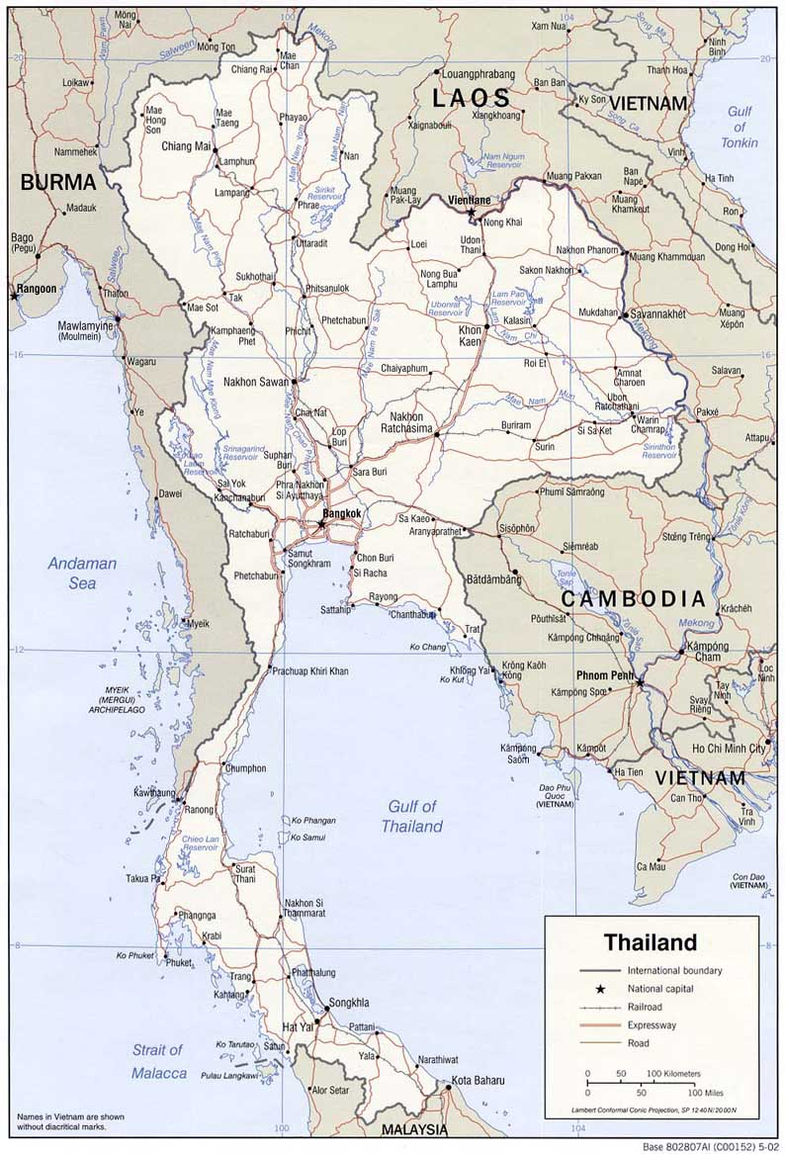

Slide 3
Ethnic groups:
Thai 95.9%, Burmese 2%, other 1.3%, unspecified 0.9% (2010 est.) (Thai Chinese: consisting of people of full or partial Chinese ancestry – particularly Han Chinese. Thailand is home to the largest overseas Chinese community in the world with a population of approximately nine million people, accounting for 14 percent of the Thai population as of 2012.)
Languages:
Thai (official) 90.7%, Burmese 1.3%, other 8%
note: English is a secondary language of the elite (2010 est.)
Religions:
Buddhist (official) 93.6%, Muslim 4.9%, Christian 1.2%, other 0.2%, none 0.1% (2010 est.)

Slide 4
Rise of modern Thailand
1782 - Beginning of the Chakri dynasty under King Rama I, which rules to this day. The country is known as Siam. New capital of Bangkok founded.
1804-1868 - Reign of King Mongkut (Rama IV), who embraces Western innovations and initiates Thailand's modernization.
1868-1910 - Reign of King Chulalongkorn. Employment of Western advisers to modernise Siam's administration and commerce. Railway network developed.
1917 - Siam becomes ally of Great Britain in World War I.
1932 - Bloodless coup against absolute monarch King Prajadhipok. Constitutional monarchy introduced with parliamentary government.
1939 - Siam changes its name to Thailand ("Land of the Free").
1941 - Japanese forces land. After negotiations Thailand allows Japanese to advance towards British-controlled Malay Peninsula, Singapore and Burma.
1942 - Thailand declares war on Britain and US, but Thai ambassador in Washington refuses to deliver declaration to US government.

Slide 5
Post-war uncertainty
1945 - End of World War II. Thailand compelled to return territory it had seized from Laos, Cambodia and Malaya. Exiled King Ananda returns.
1946 - King Ananda assassinated.
1947 - Military coup by the wartime, pro-Japanese leader Phibun Songkhram. The military retain power until 1973.
1965 onwards - Thailand permits US to use bases there during the Vietnam War. Thai troops fight in South Vietnam.

Slide 6
Short-lived civilian rule
1973 - Student riots in Bangkok bring about the fall of the military government. Free elections are held but the resulting governments lack stability.
1976 - Military takes over again.
1978 - New constitution promulgated.
1980 - General Prem Tinsulanonda assumes power.
1983 - Prem gives up his military position and heads a civilian government. He is re-elected in 1986.
1988 - General Chatichai Choonhaven replaces Prem after elections.
1991 - Military coup, the 17th since 1932. A civilian, Anand Panyarachun, is installed as prime minister.
1992 - New elections in March replace Anand with General Suchinda Kraprayoon. There are demonstrations against him, forcing him to resign. Anand is re-instated temporarily. Elections in September see Chuan Leekpai, leader of the Democratic Party, chosen as prime minister.
1995 - Government collapses. Banharn Silpa-archa, of the Thai Nation party, elected prime minister.
1996 - Banharn's government resigns, accused of corruption. Chavalit Yongchaiyudh of the New Aspiration party wins elections.

Slide 7
Government
constitutional monarchy; note - interim military-run government since May 2014
many previous; interim constitution - replacing the 2007 permanent constitution - signed by the king 22 July 2014; first draft of new constitution completed 17 April 2015, rejected by drafting committee 6 September 2015; final draft completed by new drafting committee 29 March 2016, passed by referendum 7 August 2016 (2016)
chief of state: Privy Council President PREM Tinsulanonda serves as Regent (since 13 October 2016); note - King PHUMIPHON Adunyadet, also spelled BHUMIBOL Adulyadej (since 9 June 1946) died 13 October 2016. Crown Prince became King Vajirlongkorn (Rama Varma X) was enthroned on December 1, 2017, his reign started on Oct. 13, 2016 retrospectively.
head of government: Interim Prime Minister Gen. PRAYUT Chan-ocha (since 25 August 2014) 76 provinces

Slide 8
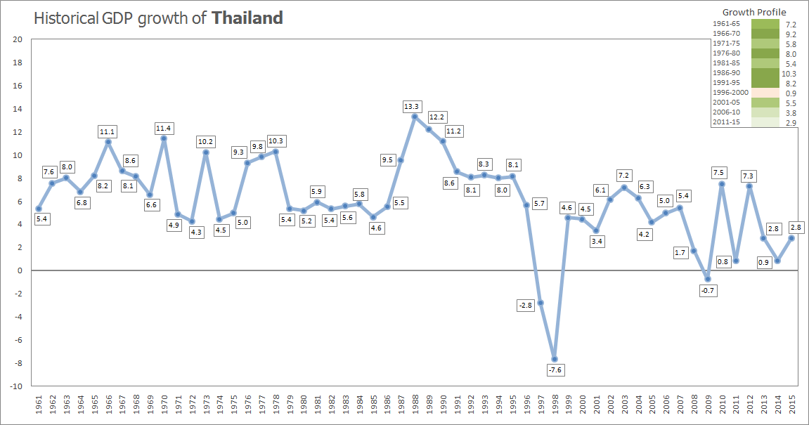
https://upload.wikimedia.org/wikipedia/commons/7/76/Istorical_GDP_growth_of_Thailand.png

Slide 9
Burma (Myanmar)

Slide 10
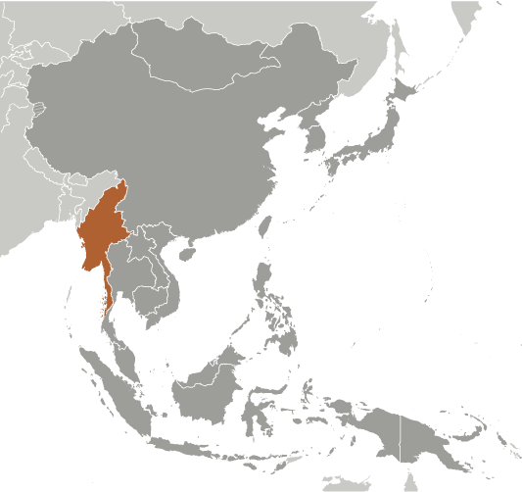
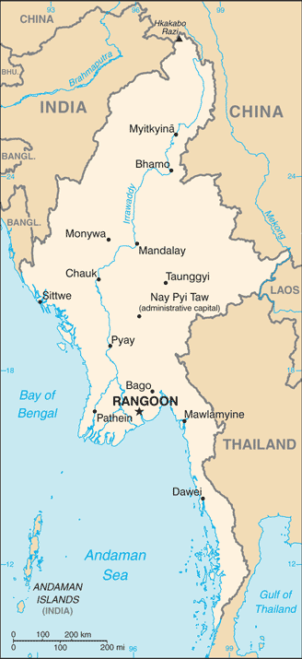
On Map

Slide 11
Ethnic Groups, Religions and Regions
Burman 68%, Shan 9%, Karen 7%, Rakhine 4%, Chinese 3%, Indian 2%, Mon 2%, other 5% (Rohingya)
Buddhist 87.9%, Christian 6.2%, Muslim 4.3%, Animist 0.8%, Hindu 0.5%, other 0.2%, none 0.1%
7 regions (taing-myar, singular - taing), 7 states (pyi ne-myar, singular - pyi ne), 1 union territory
regions: Ayeyawady (Irrawaddy), Bago, Magway, Mandalay, Sagaing, Taninthayi, Yangon (Rangoon)
states: Chin, Kachin, Kayah, Kayin, Mon, Rakhine (Arakan), Shan
union territory: Nay Pyi Taw

Slide 12
Chronology: Burma (Myanmar)
From time Immemorial through the 19th century: Various ethnic Burmese and ethnic minority city-states or kingdoms occupied the present borders.
1824-1886: Over a period of 62 years, Britain conquered Burma and incorporated the country into its Indian Empire.
Until 1937: Burma was administered as a province of India and became a separate, self-governing colony;
1948, Burma attained independence from the British Commonwealth. Parliamentary Government under U Nu: Pyidawtha, Buddhist utopia. The Time of Troubles (1948-58).
1958: The Tatmadaw and General Ne Win’s “constitutional coup”.
From 1962 to 1988: After military coup in 1962 Gen. NE WIN dominated the government, first as military ruler, then as self-appointed president (1971), and later as political kingpin (1981). “Burmese Way of Socialism.”
In 1988: Monetary change. “8888 Uprising” and crackdown. NE WIN resigned from the head of BSPP (Burmese Socialist Program Party), but within months the military crushed student-led protests and took power.
September 1988: General Saw Maung, State Law and Order Restoration Council (SLORC). In 1997, SLORC was renamed as “State Peace and Development Council” (SPDC).
In 1990: Multiparty legislative elections resulted in the main opposition party - the National League for Democracy (NLD) - winning a landslide victory.
Instead of handing over power, the junta placed NLD leader (and Nobel Peace Prize recipient) AUNG SAN SUU KYI under house arrest from 1989 to 1995, 2000 to 2002, and from May 2003 to November 2010.

Slide 13
In late September 2007, the ruling junta brutally suppressed protests over increased fuel prices led by prodemocracy activists and Buddhist monks, killing at least 13 people and arresting thousands for participating in the demonstrations. The “Saffron Revolution”
In early May 2008, Burma was struck by Cyclone Nargis, which left over 138,000 dead and tens of thousands injured and homeless. Despite this tragedy, the junta proceeded with its May constitutional referendum, the first vote in Burma since 1990.
In November 2010: Legislative elections held, which the NLD boycotted and were considered flawed by many in the international community, saw the ruling Union Solidarity and Development Party garner over 75% of the seats.
In January 2011: The national legislature convened and selected former Prime Minister THEIN SEIN as president. The “Disciplining-flourishing Democracy”.
In April 2012: AUNG SAN SUU KYI was elected to the national legislature and became chair of the Committee for Rule of Law and Tranquility.
In November 2015: In a flawed but largely credible national legislative election featuring more than 90 political parties, the NLD again won a landslide victory. HTIN KYAW, AUNG SAN SUU KYI’s confidant and long-time NLD supporter, was elected as president.
On 30 March 2016: Burma's first civilian government after more than five decades of military dictatorship was sworn into office. Aung San Suu Kyi special role: State Counselor, above the president.

Slide 14
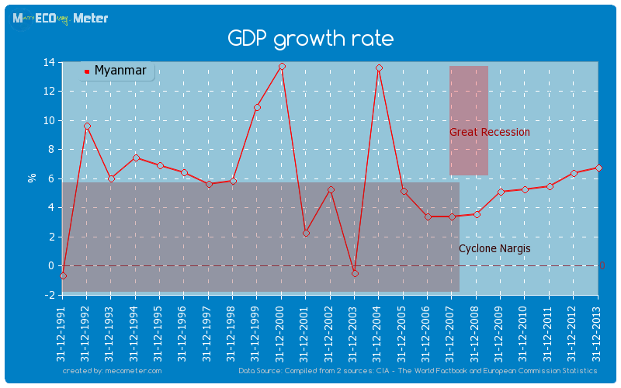

Slide 15
Burma's Saffron Revolution (2008)
Burma's Saffron Revolution (2008) A Film by Ashin Yevata
https://www.youtube.com/watch?v=hh6ZlASRQd0
Saffron Revolution: A Nonviolent Army for Democracy
https://www.youtube.com/watch?v=z1lmXnQldMY

Slide 16
The Rohingya Crisis
Myanmar's Anti-Muslim Monks
https://www.youtube.com/watch?v=GtAl9zJ3t-M

Slide 17
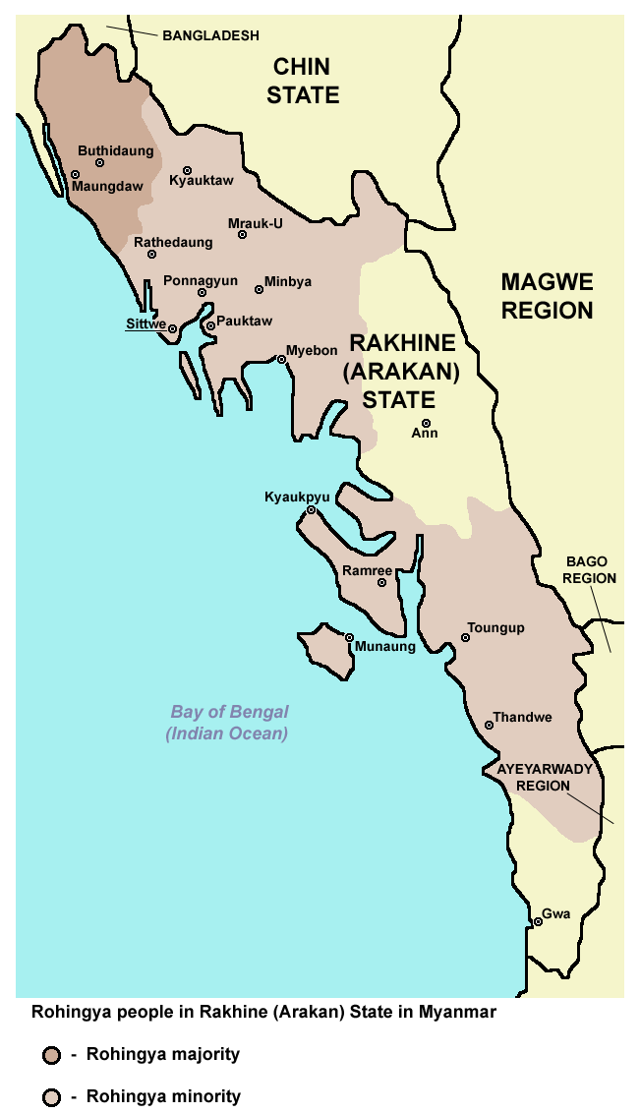
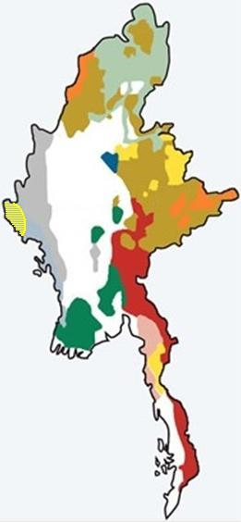

Slide 18
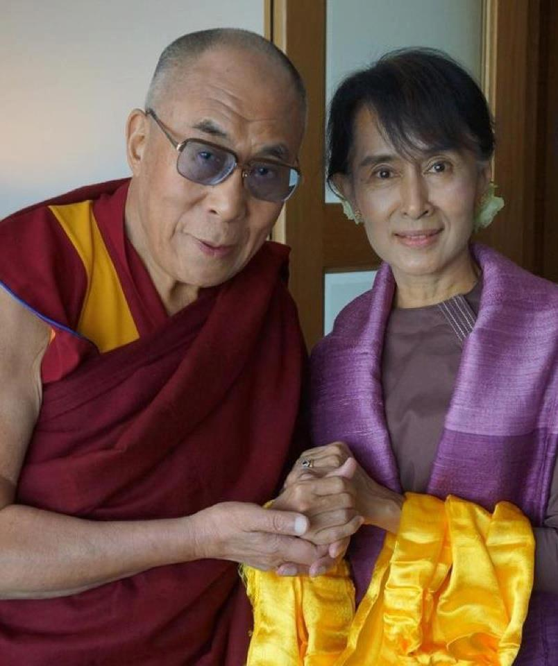

Slide 19


Slide 20
Comparison between Thailand and Burma
Colonial Background
Global Alliance and Ideological Predilection: Nonaligned vs. U.S. ally, Left-wing, socialist vs. Right wing, capitalist.
Development Strategy: Isolation vs. Globalization (export-led)
Role of the Military: the Tatmadaw (Royal Force) in Burma
Causes for the Strong Presence of Military in Politics: Foreign Wars or Domestic Ethnic Riots
Pathway for Democratization: Parliamentary and Constitutional Monarchy
Quality of Governance and State Capacity
Role of Monarchy in Thailand (Crown Property Bureau) and Buddhist Monastery in Burma: Organized Power Center
Role of Students: Student Movements
Foreign Threats or Border Troubles

