Slide 1
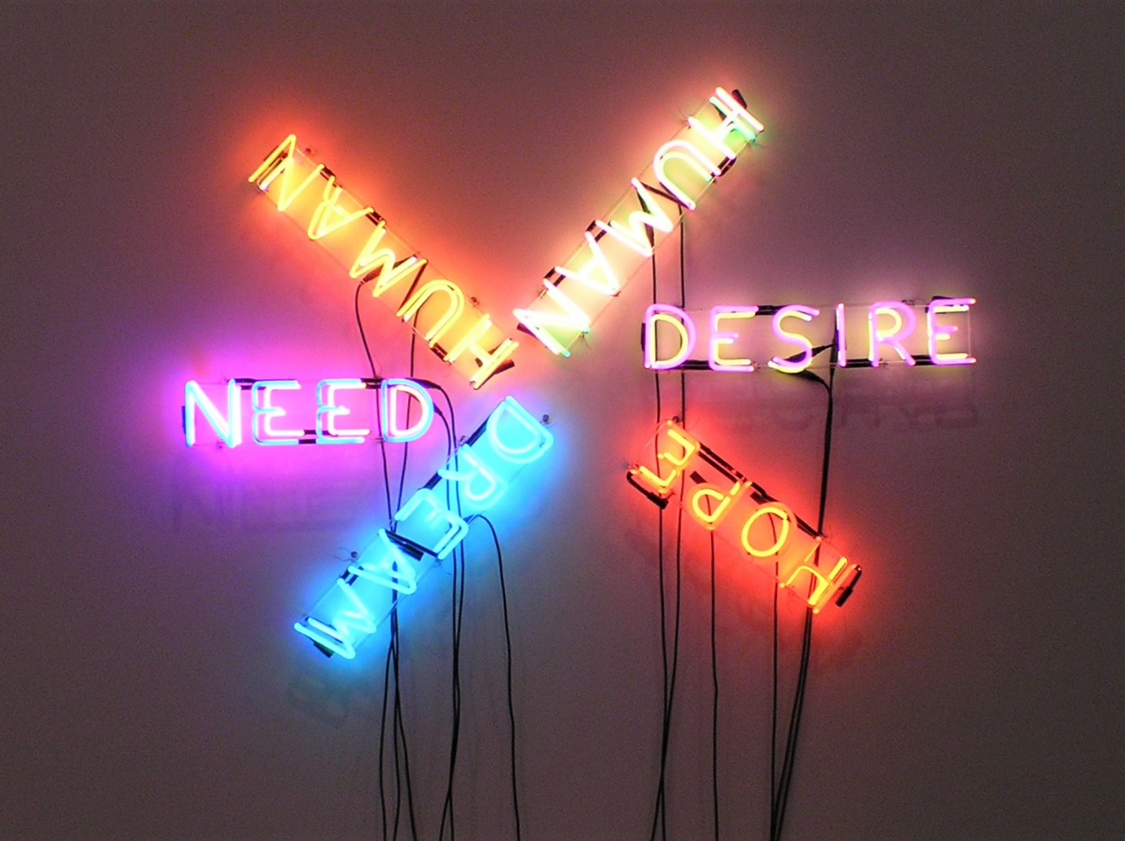
Conclusion
IPE and the Future of Humanity
Notes:
NOTE:
To change the image on this slide, select the picture and delete it. Then click the Pictures icon in the placeholder to insert your own image.

Slide 2
Introductory Remarks
As I told all of you in the first class: I believe that IPE is the most important class that every college student should take; at this moment I insist on my point of view.
Your lives from childhood to adolescence have been punctured and interwoven with globalization and financial crises more than any other generation: the dot.com bubble burst (2001-02), Sept. 11th attack/Wall Street Crash, 2007 Subprime mortgage crisis, 2008 Great Recession, and the 2020 Global Pandemic/Great Recession. The current crisis has already brought down countries such as Lebanon, Argentina, companies such as Sears, Neiman Marcus, J.C. Penney, J. Crew and more will follow. Your knowledge of IPE surely will equip you with better analytical tools and foresights to navigate through the difficult waters coming upon the coming years.
To wrap us our entire semester of more than two dozen lectures, I am going to use several “I”s to imprint the most important lessons upon your memory: Identity, Ideal, Interest, Institution.

Slide 3
Interest
The hallmark of your adulthood is that you have been able to realize and understand your interest. The most important point is very materialistic: 99.99% of human history has been a struggle for survival—securing food and shelter. So every able-bodied person should ask: Can I carry my own weight and go on? If your answer is yes, then, ask: Can I maintain a family so I can raise child? If you can accomplish this, then ask: Can I make a contribution to the society so some other young and old, disabled, less-fortunate people (sickness can strike anyone) who cannot take care of themselves can be taken care?
To maintain life and livelihood of you, your family, and your community, we have to be able to first think like an economist. After all, this class is an economics class, so “The Economist View of the World” (It is a book title by Stephen E. Rhoads, 1985) must inform us about the concepts such as scarcity of resources, opportunity cost (resource, including time, life can be wasted!), marginalism, cost-effective analysis, and incentive. Being rational means that you can apply all these concepts to optimally achieve your goals in life.
For individual and nation-state, wealth in all forms is the foundation for all other goals, its importance is only secondary to capacity to create wealth, mainly knowledge.
Our society do not really need a lot of Don Quixotes who ride an old horse with inadequate spear to fight a windmill.

Slide 4
Institution
We have discussed that anarchy is the enemy of wealth and a fatal obstacle to wealth-creation. To encourage wealth-creation and to organize collective action, institutions are created: property right, state, nation-state, civil society, market, MNCs, etc. At the global level, empire, the Pax Romana, the Pax Britannica, the Pax Americana UN, and the entire Bretton Woods system created and maintained under the American leadership, have been created to serve the purpose of peace and prosperity.
As a political science sub-discipline, IPE has emphasized the necessity and importance of institutions and institution-building for global peace and prosperity. Institutions work in a way to mitigate or resolve conflicts among individuals, states, and market participants under the circumstances of competition for scarce resources.
It takes generations of geniuses, great minds, visionary leaders, efforts and sacrifices to build institutions, which are signs of human civilization and evolution. So it is dangerous for us not to appreciate this institutional evolution process. Anarchists, revolutionaries, Luddites, terrorists, demagogues, empowered “breakers” and social quacks can prescribe all kinds of medicines that are worse than the disease. One of these poisonous medicines often is “Down with___! ”(This or that institution. You can fill the blank).

Slide 5
Future Scenarios of the World: Mapping the Global Future: 2020, from NIC Report 2009
Davos World provides an illustration of how robust economic growth, led by China and India, over the next 15 years could reshape the globalization process—giving it a more non-Western face and transforming the political playing field as well.
Pax Americana takes a look at how US predominance may survive the radical changes to the global political landscape and serve to fashion a new and inclusive global order.
A New Caliphate provides an example of how a global movement fueled by radical religious identity politics could constitute a challenge to Western norms and values as the foundation of the global system.
Cycle of Fear provides an example of how concerns about proliferation might increase to the point that large-scale intrusive security measures are taken to prevent outbreaks of deadly attacks, possibly introducing an Orwellian world.

Slide 6
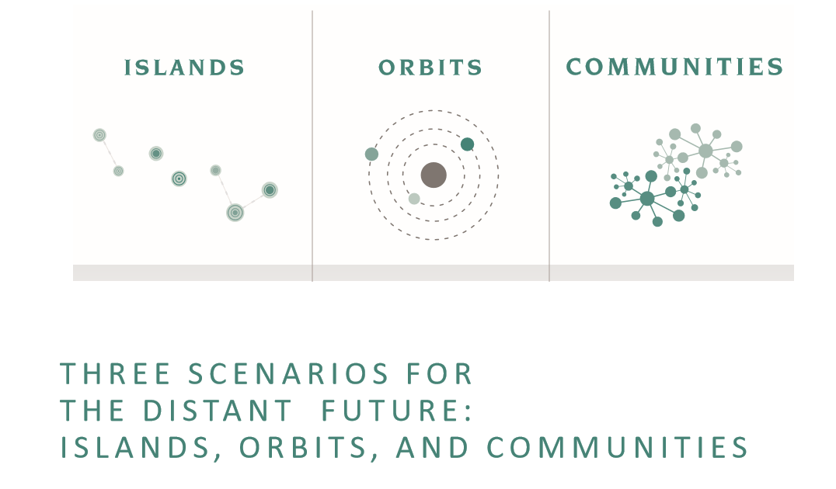
Different Scenarios of Global Future, from 2017 NIC Report: Global Trends: Paradox of Progress
These scenarios emphasize alternative responses to near-term volatility—at the national (Islands), regional (Orbits), and sub-state and transnational (Communities) levels

Slide 7
Islands: a restructuring of the global economy, long periods of slow or no growth, challenging both traditional models of economic prosperity and the presumption that globalization will continue to expand; challenges to governments in meeting societies’ demands for both economic and physical security, popular pushback to globalization increases, emerging technologies transform work and trade, and political instability grows. Some governments might turn inward, reduce support for multilateral cooperation, and adopt protectionist policies, while others find ways to leverage new sources of economic growth and productivity.
Orbits: competing major powers seeking their own spheres of influence, creating tensions globally while attempting to maintain stability at home. Rising nationalism, changing conflict patterns, emerging disruptive technologies, and decreasing global cooperation, all increase the risk of interstate conflict. The policy choices ahead for governments that would reinforce stability and peace or further exacerbate tensions. It features a nuclear weapon used in anger, which turns out to concentrate global minds so that it does not happen again.
Communities: growing public expectations but diminishing capacity of national governments open space for local governments and private actors, challenging traditional ideas on governing; Information technology remains the key enabler, and companies, advocacy groups, charities, and local governments prove nimbler than national governments in delivering services; Most national governments resist, but others cede some power to emerging networks. Everywhere, from the Middle East to Russia, control is harder.

Slide 8
Idea and Ideal
Homo sapiens are distinguished from other animals by being the language animal. Language, both spoken and written forms, gives people the ability to think, and to think reflectively, which defines the fundamental quality of our humanity. The French philosopher Rene Descartes’ axiom, “Cogito, ergo sum” (“I think, therefore, I am!”) should be understood in this context.
Idea, in comparison to the matter it describes, is perfect, as Plato said more than two thousand years ago. Idea must have intrinsic idealistic tendency. Ideas and ideals are created and built into systems of thinking with internal compatibility and logical consistency, as well as unity with human values, many are regarded as universal values.
Idea/ideal have become the intellectual and mental foundation or the lodestar for institution-building. We can rarely see institutions that do not reflect some fundamental ideas and values. The space of public discourse is serving the purpose to make sure that ideas are serving the interest of humanity.
Thinkers, who can be neither politicians who are power-holders nor businesspeople who are wealth-seekers, can develop a more detached position to develop universal values for the entire humanity. Although different thinkers may serve different groups and interests differently, the clash of these different ideas is carried out in the public sphere of civil society, therefore, the fairness and justice of institutions can be examined and safeguarded.
As I have discussed, globalism needed to be reconstructed, universal values to be instilled into the “global value chains”.

Slide 9
Quotes to end this semester:
Now let me say a few words about Identity: we construct our identity (or plural identities) based upon a diversity of ideas, experiences, interests, and values. At the human level, I do not think we can achieve oneness in this world; therefore, we have to try to accommodate each other with different interests and ideas. “I live, let live!”, not “I live, let die!” For this reason, I have presented a variety of political ideologies or theories in this class from the beginning to the end. Which one is better? It depends upon your position in the society, your interest, and your ideal for our society. I hope you will carry a carpenter’s tool box: you have different tools for different issues under different circumstances; also, you have the ability to understand other people and nation-states who follow different sets of interests and ideas.
But remember this Talmudic saying:
  If I am not for myself, who will be for me?
  If I am for myself only, what am I?
  If not now—when?
President Reagan famously added to this saying:
  If not us— then who?

Slide 10
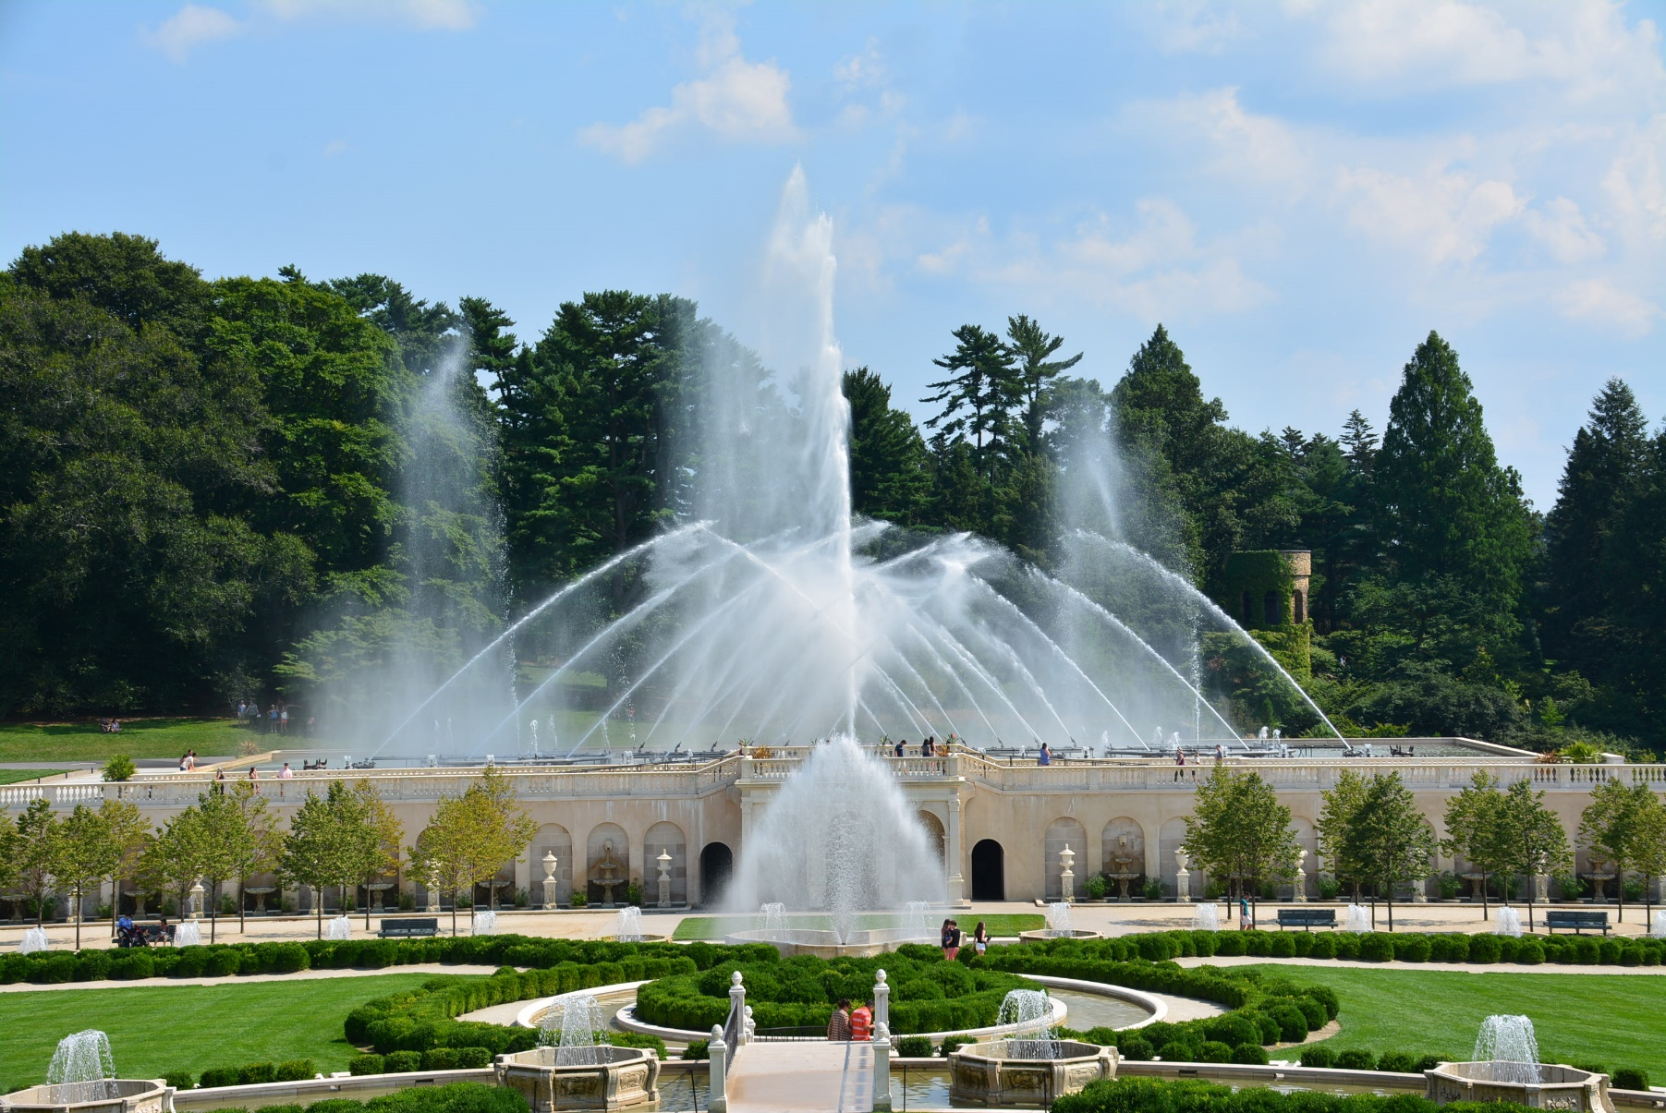
The Spring/Summer Garden Is Still Waiting for us!

Slide 11
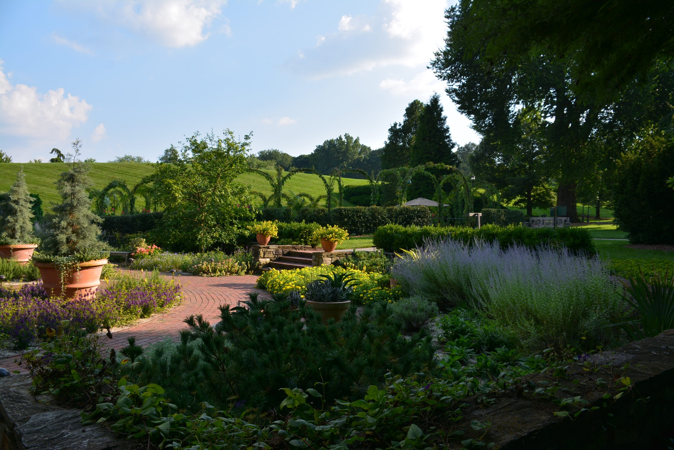

Slide 12
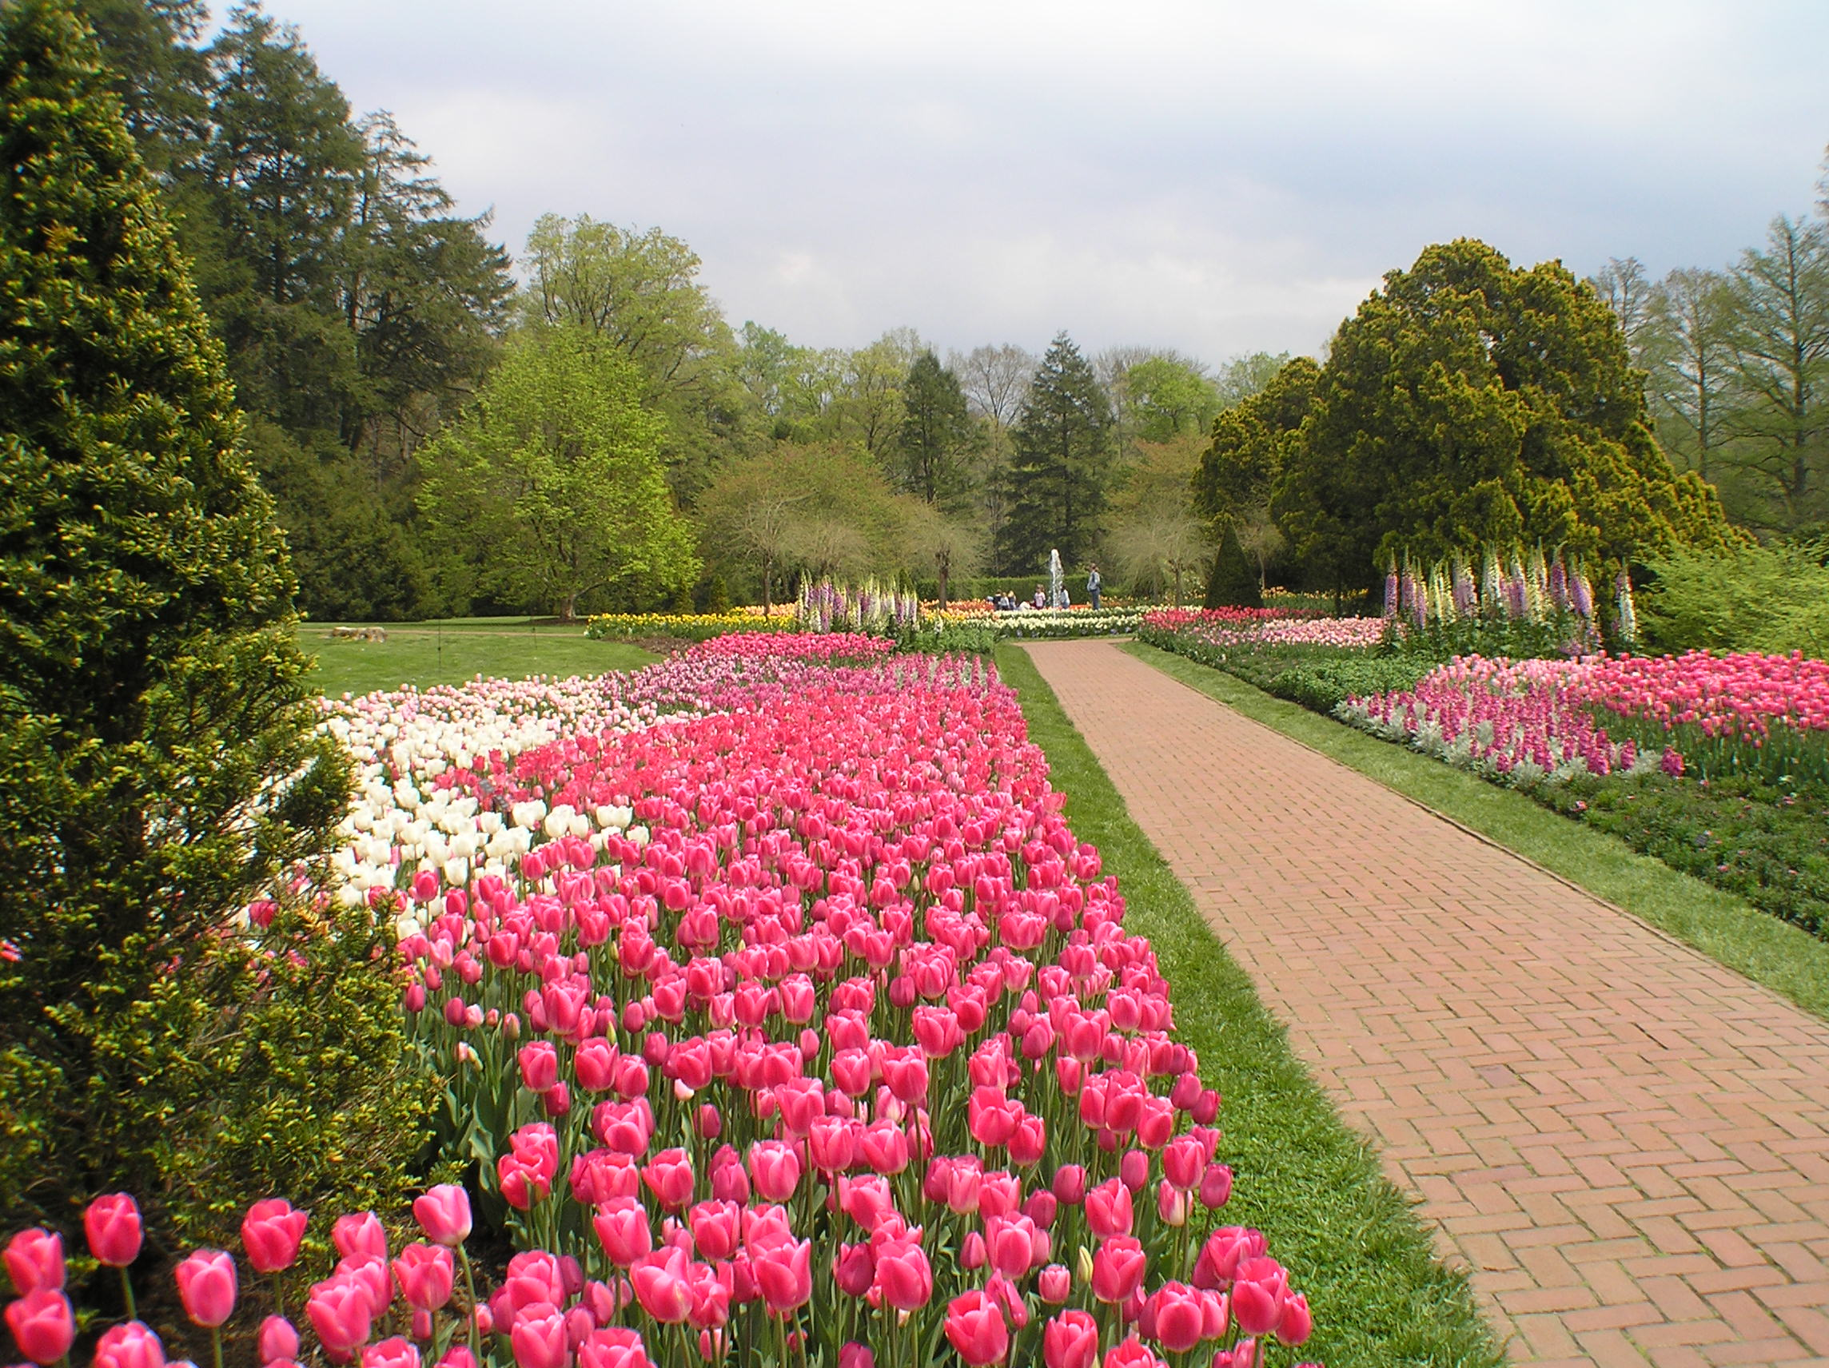
These pictures were taken at Longwood Gardens, Pennsylvania! Please go to visit!
Disclosure regarding conflict of interest: I reveal that I deem Pennsylvania as my home state since I graduated from Temple University, a part of PA commonwealth education system.

Slide 13
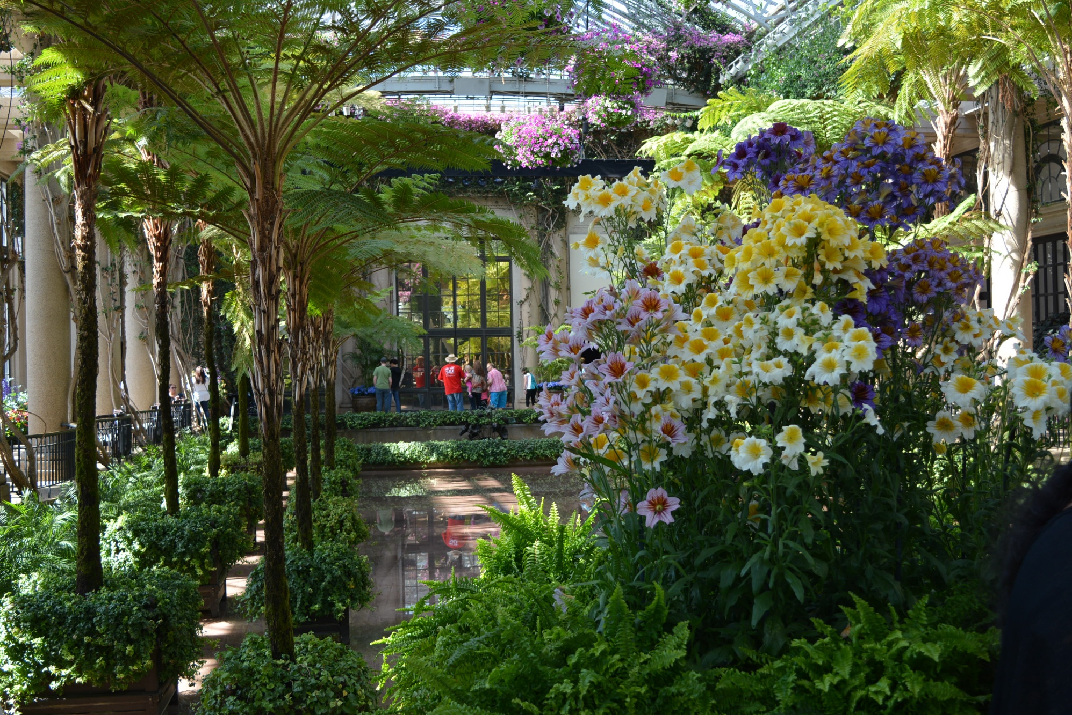

Slide 14
